Slide 1
Language Translation service
English to French
By Harsh Bhargava

Slide 2
Aim of the Project
Build scalable GRU based translator for English to French translation
Compare the performance of the model with and without the implementation of Attention mechanisms
Improve the Bleu score over EuroParl Data compared to vanilla models

Slide 3
Why Language Translation?
Global Communication
Content Accessibility
E-Commerce and Business Expansion
Travel and Tourism
Localization of Software and Media

Slide 4
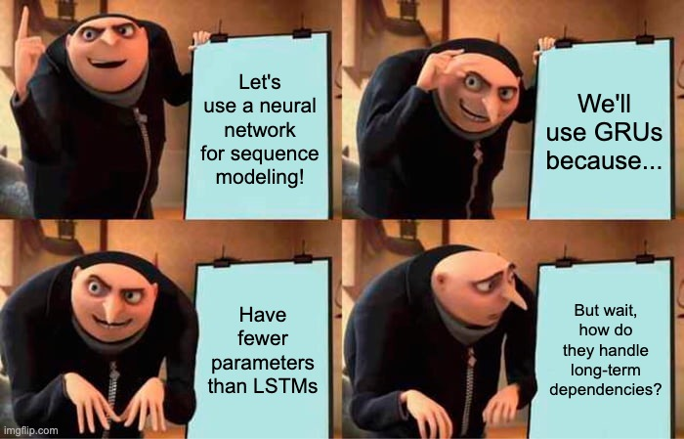
Why GRU?
Requires less parameters to converge
Faster Convergence
Less data hungry than a transformer model

Slide 5
Architecture

Slide 6
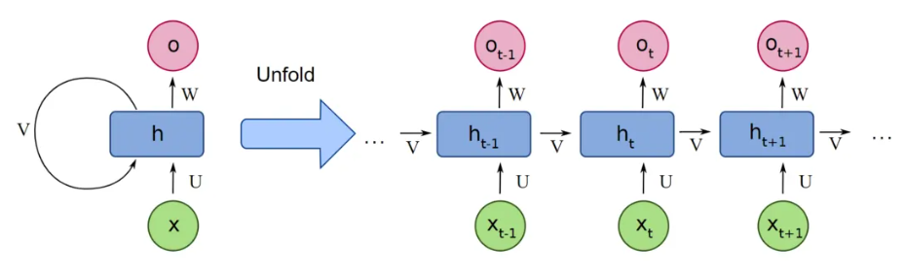
Recurrent Neural Network

Slide 7
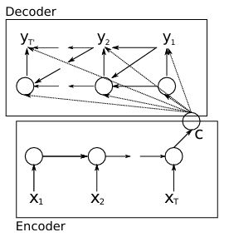
Encoder
Processes input sequence X₁, X₂, …, X_{T} (English)
GRU Units encode the sequence into hidden state
C is a fixed length vector (1000 dimension in paper)
Decoder
Generates output sequence Y₁, Y₂, …, Y_{T} (French)
Utilizes h_{<t-1>}, Y_{t-1} and C for computing h_{t}

Slide 8
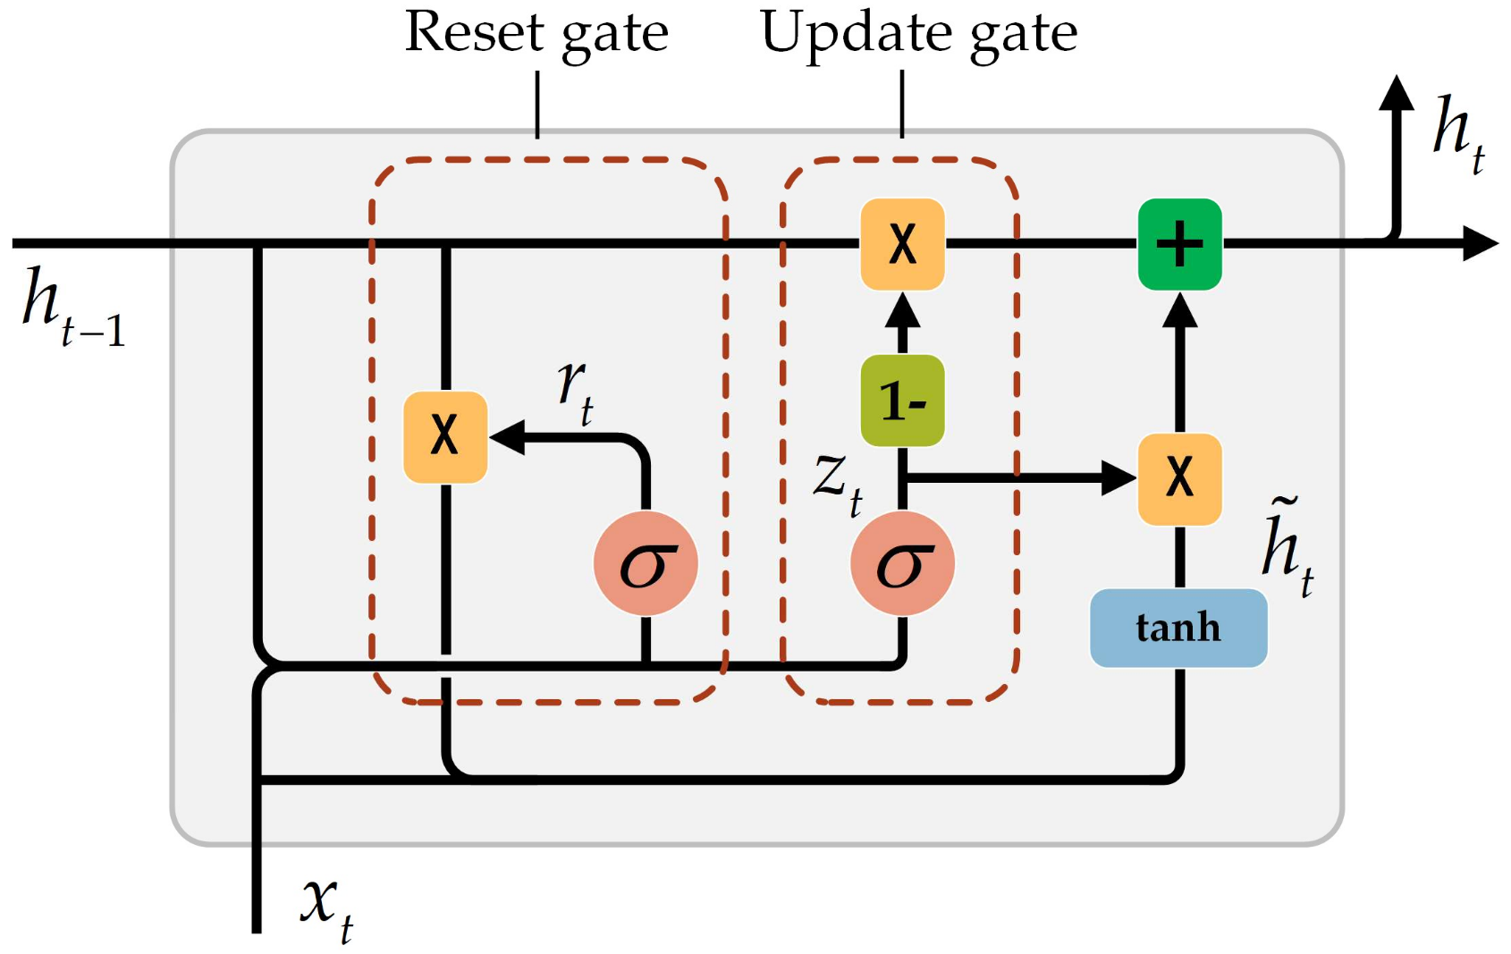
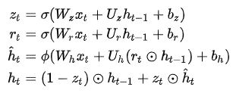
Gated Recurrent Unit

Slide 9
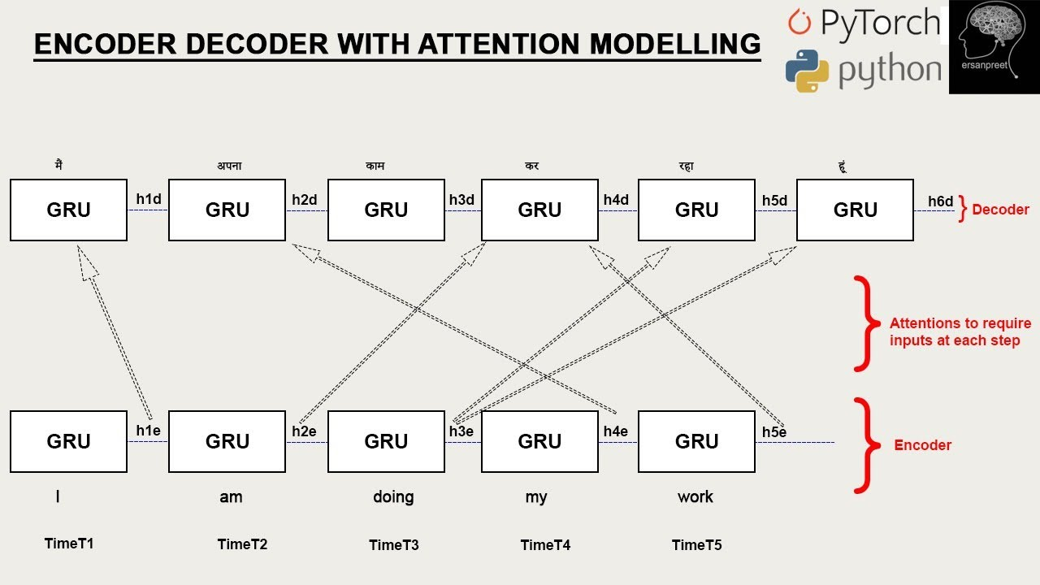
Attention
Let the decoder focus on specific part of the input
Overcomes bottleneck of fixed C
Handles long dependencies well

Slide 10
Architecture Used : Without Attention

Slide 11
Architecture Used : With Attention

Slide 12
Dataset

Slide 13
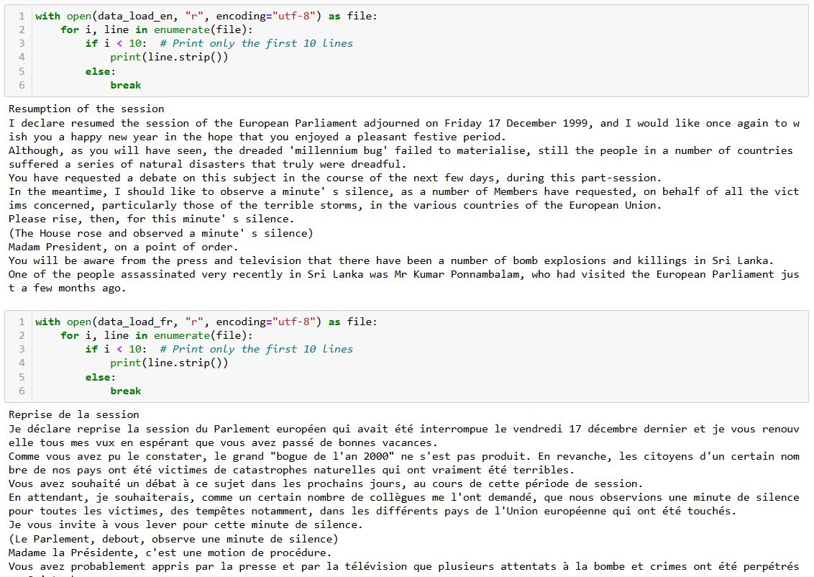
EuroParl Data
The Europarl Corpus is a corpus (set of documents) that consists of the proceedings of the European Parliament from 1996 to 2012
Consists of two files europarl-v7.fr-en.en and europarl-v7.fr-en.fr
Average sentence length is about 30 words in both the datasets

Slide 14
Terminology Alert!!!
Teacher Forcing
BLEU Score
Train/Test/Validation Set
Beam Search

Slide 15
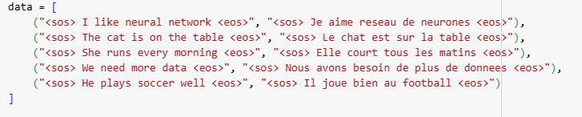
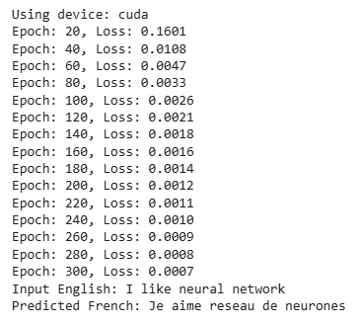
Plan of Action
Create a GRU based Encoder-Decoder structure
Use to train smaller dataset ~ 5 sentences
Introduce Attention Mechanism
Train both models on EuroParl Data

Slide 16
Methodology
Loading Dataset
Splitting into sentences
Preprocessing sentences
Splitting into Train/Validation/Test sets
Building Vocabulary
Tokenization and Conversion to Tensor
Batching
Model Initialization and Training
Evaluation
Inference

Slide 17
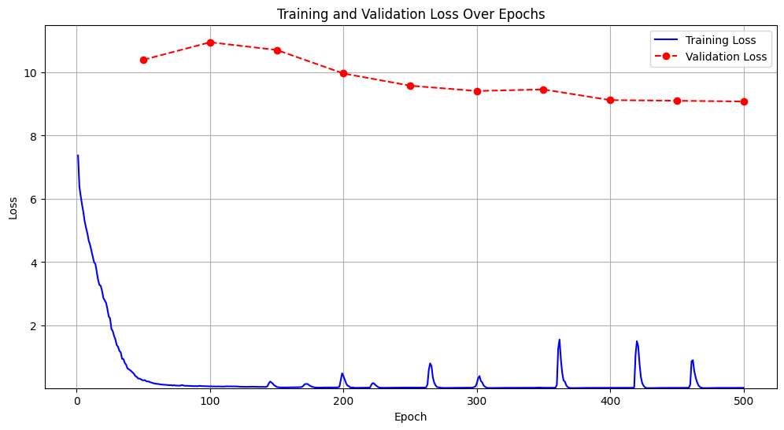
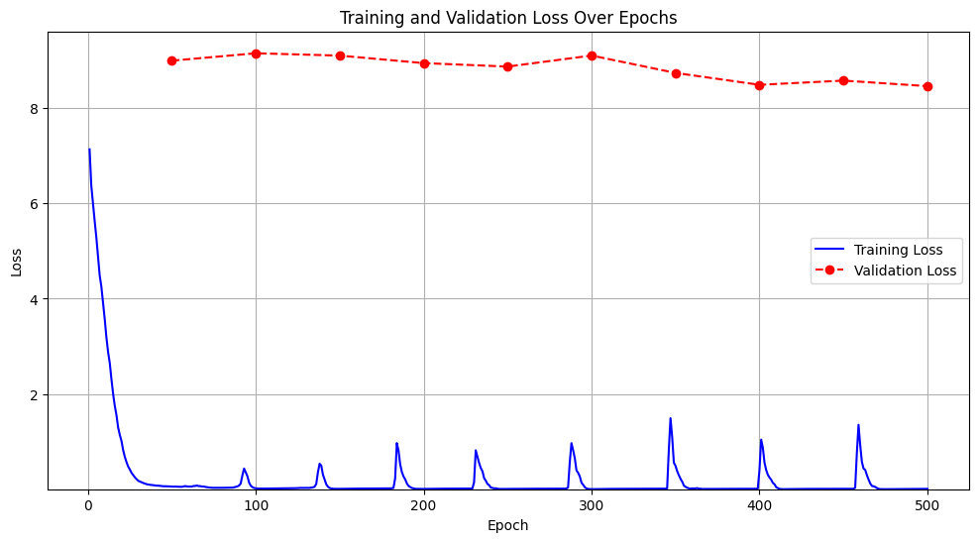
Training Results : Without Attention Vs With Attention
WITHOUT ATTENTION
WITH ATTENTION

Slide 18
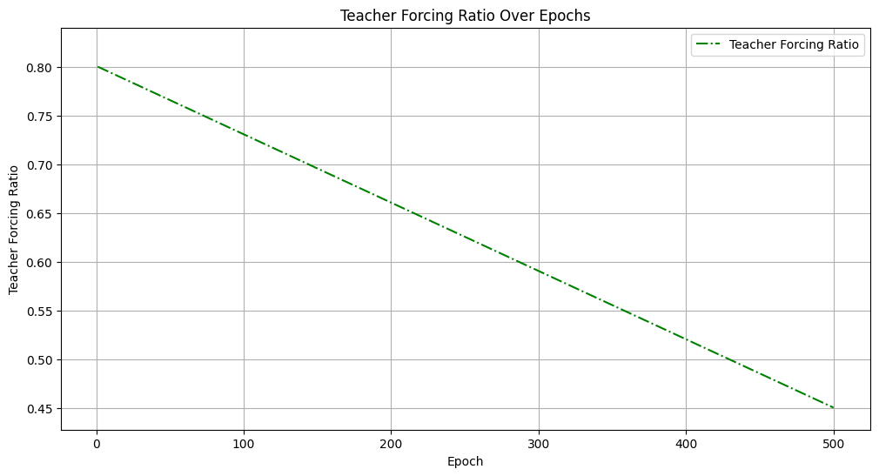
Training Results : Without Attention Vs With Attention
Without Attention
With Attention

Slide 19
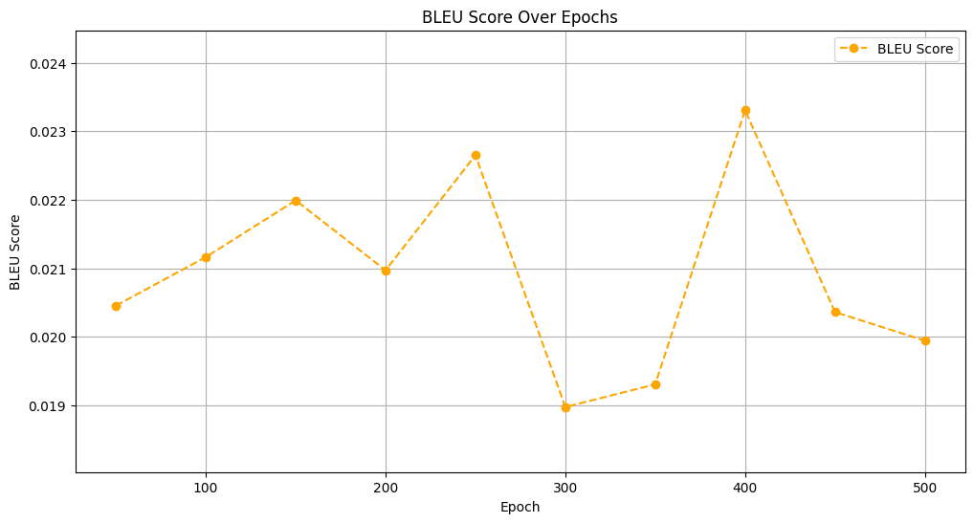
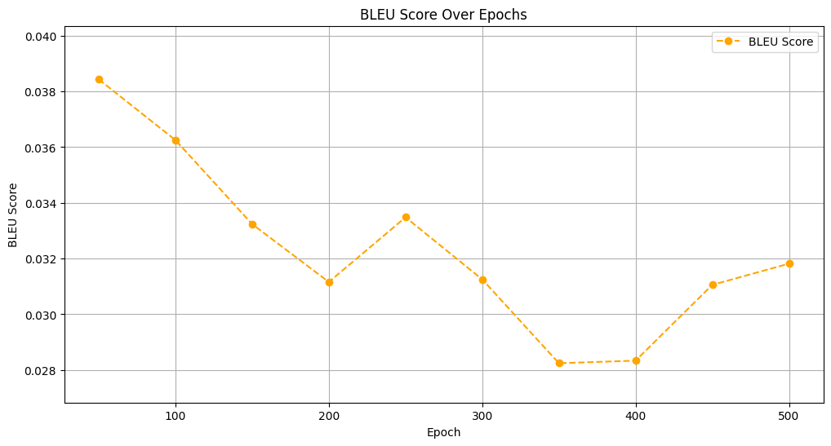
Training Results : Without Attention Vs With Attention
Without Attention
With Attention

Slide 20
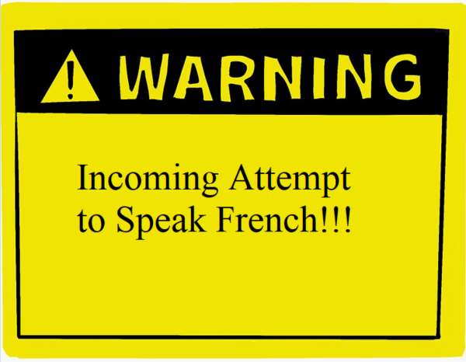

Slide 21
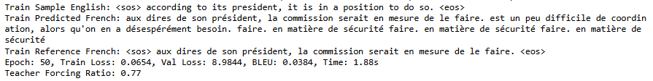
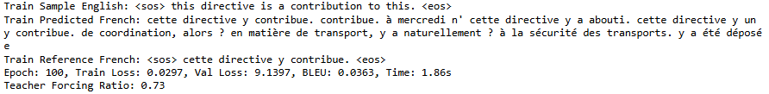
Understanding Ground Reality: Attention Model

Slide 22

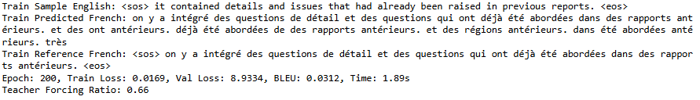
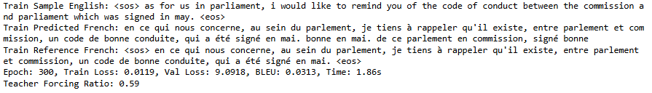

Slide 23
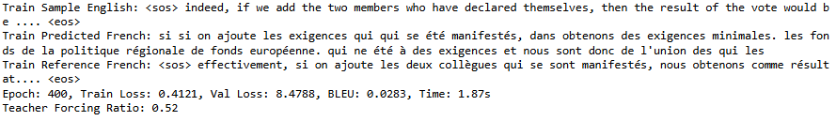


Slide 24
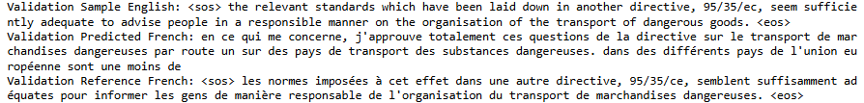


Epoch-100
Epoch-250
Epoch-500

Slide 25
LET’S SCALE!!!

Slide 26
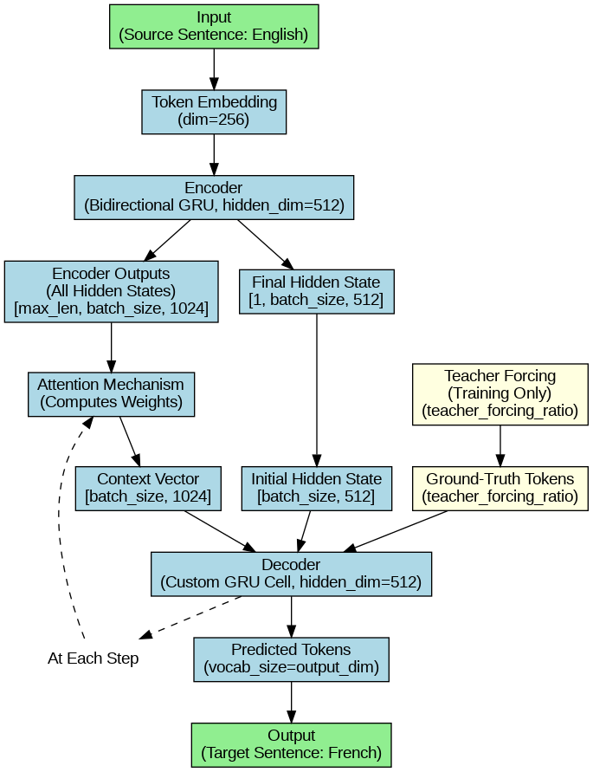
Modified Architecture

Slide 27
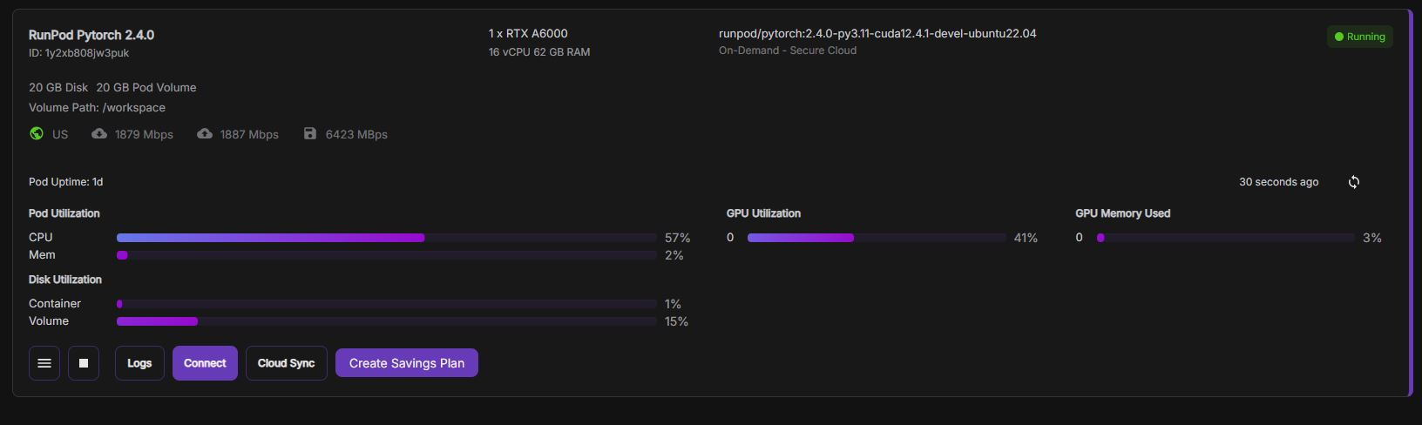
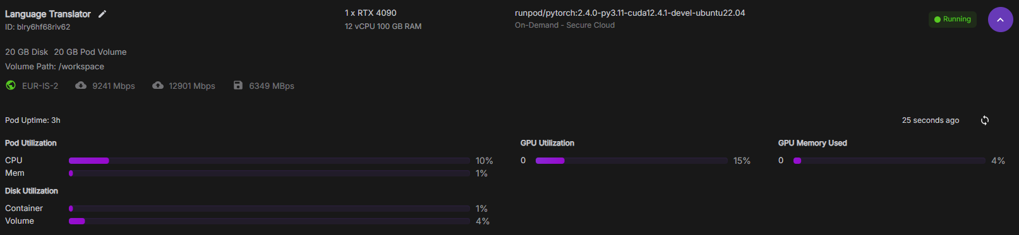
GPU Used for Training

Slide 28
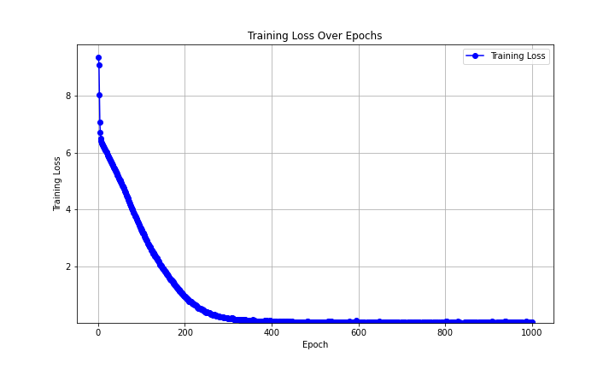
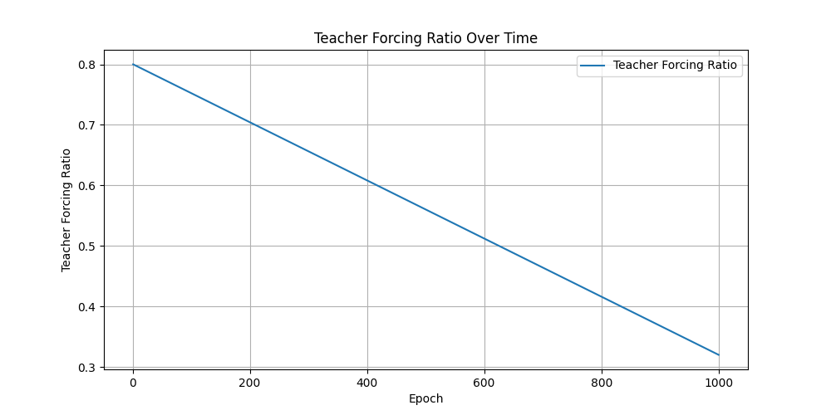
Training Results : 5000 sentences - 1000 Epochs

Slide 29


Training Loss
Validation Loss

Slide 30
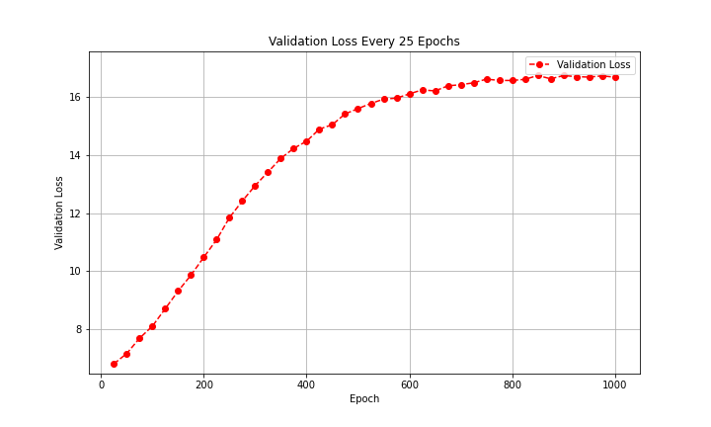
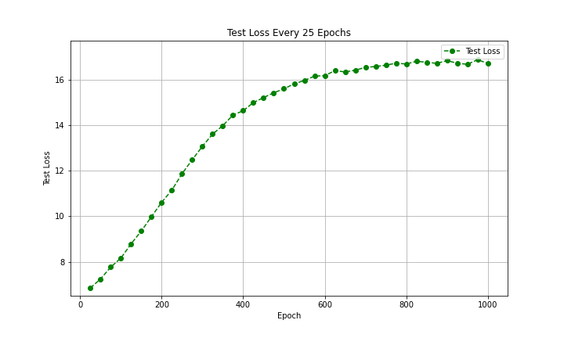
Validation and Test Loss

Slide 31
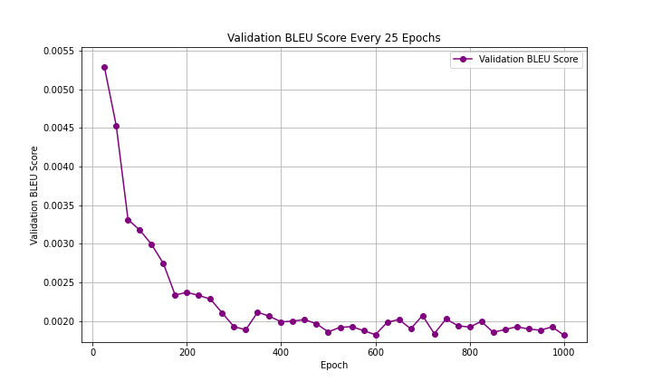
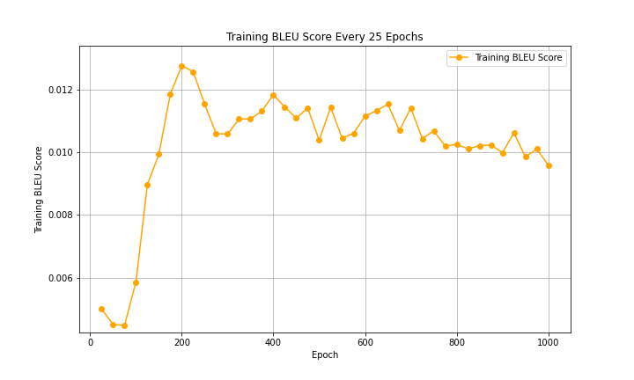
Bleu Score

Slide 32
Validation Loss Vs BLEU Score
Validation Loss
How well is the next token predicted
Indicates Overfitting
Helps in hyperparameter tuning
BLEU Score
Rates translation quality

Slide 33
Hyperparameter Tuning

Slide 34
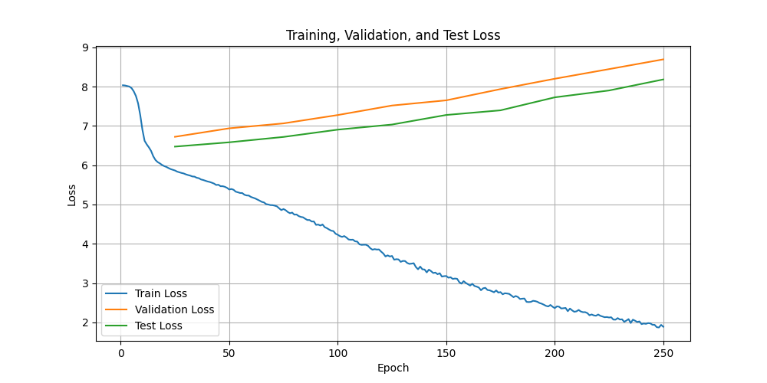
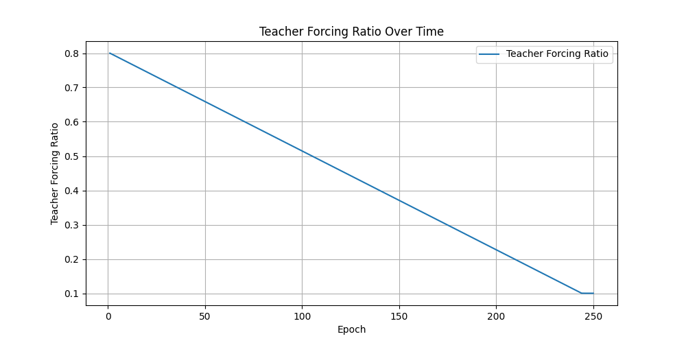
500 Sentences – 250 Epochs

Slide 35
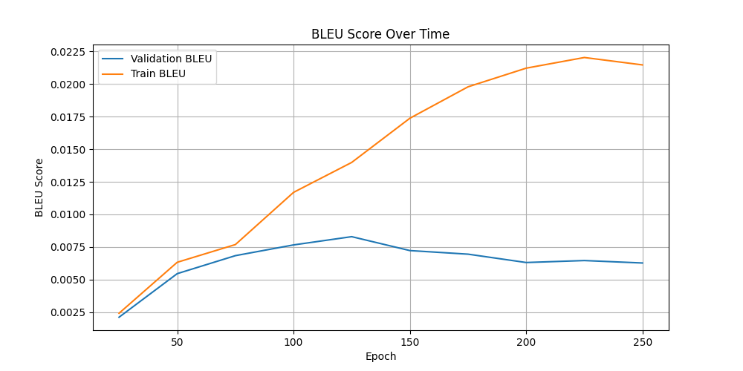
500 Sentences – 250 Epochs

Slide 36
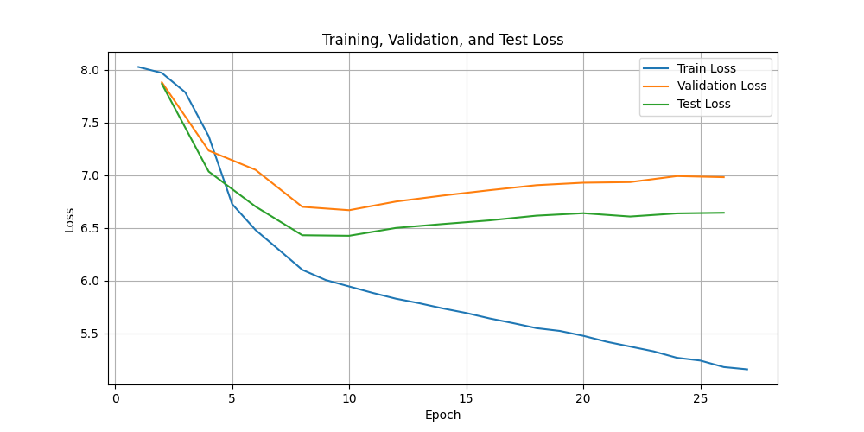
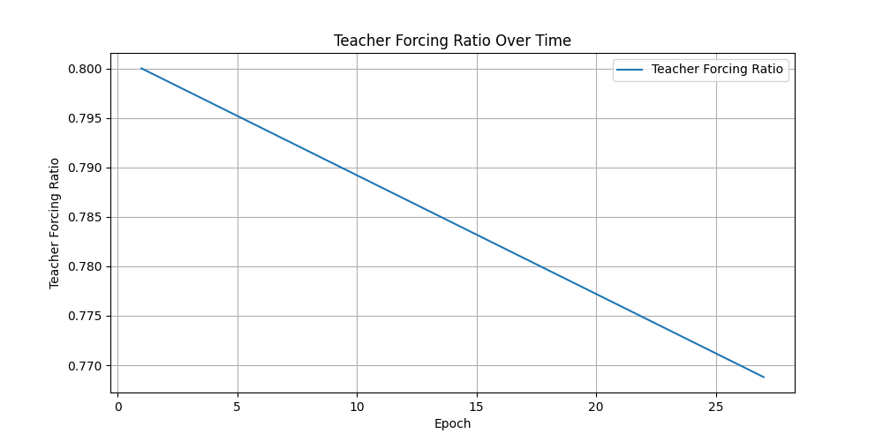
500 Sentences – 27 Epochs

Slide 37
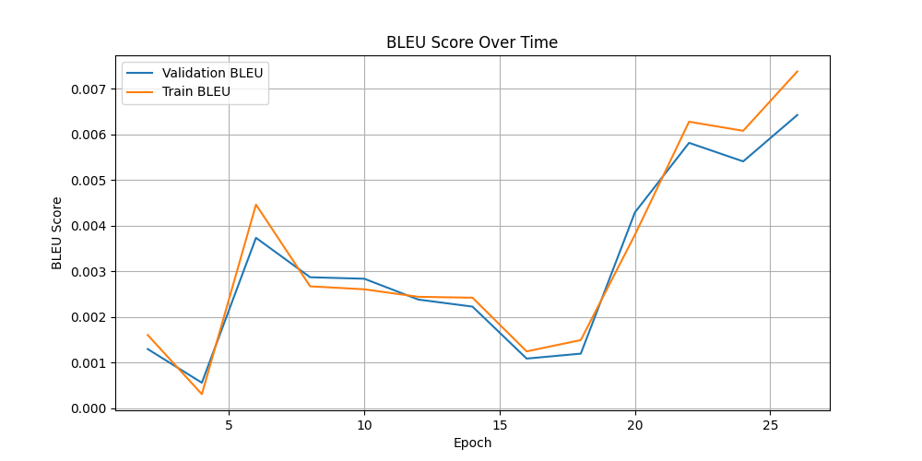
500 Sentences – 27 Epochs

Slide 38
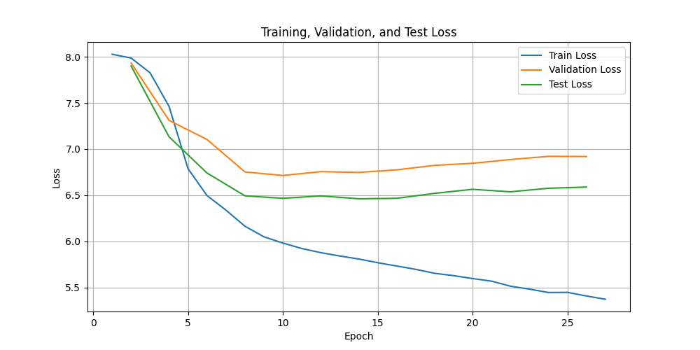
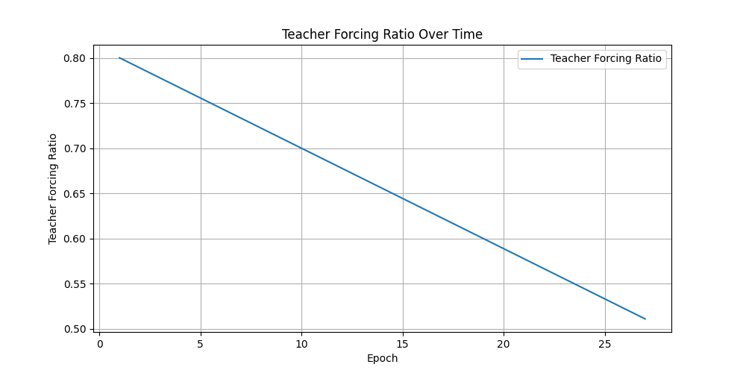
500 Sentences – 27 Epochs (Faster TF Decay)

Slide 39
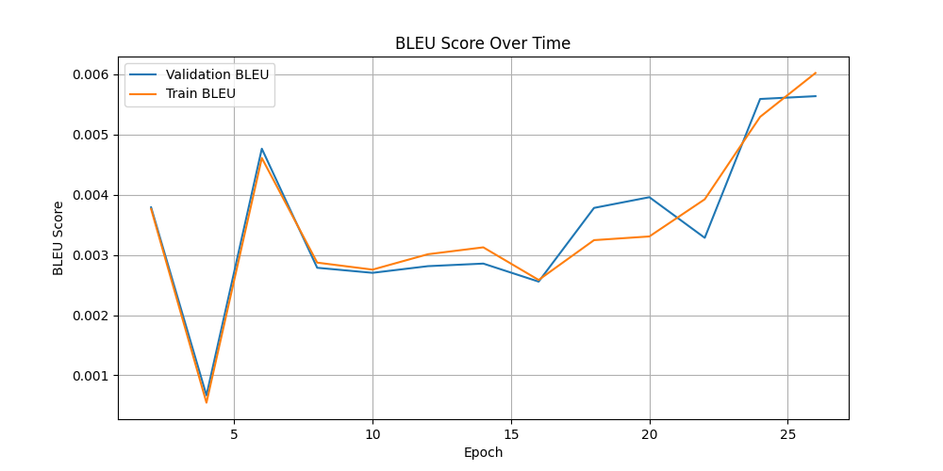
500 Sentences – 27 Epochs (Faster TF Decay)

Slide 40
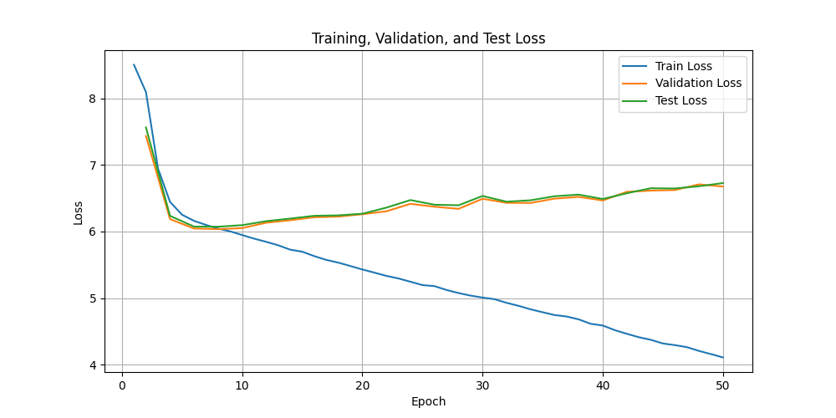

1500 Sentences – 50 Epochs

Slide 41
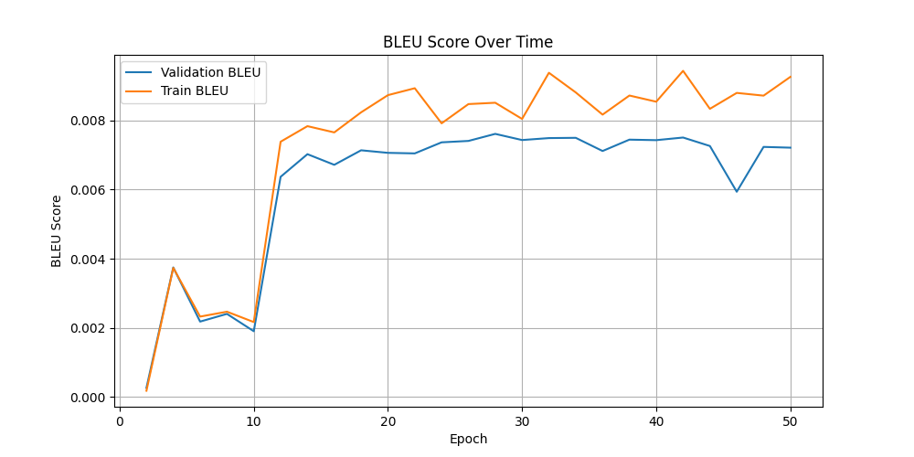
1500 Sentences – 50 Epochs

Slide 42
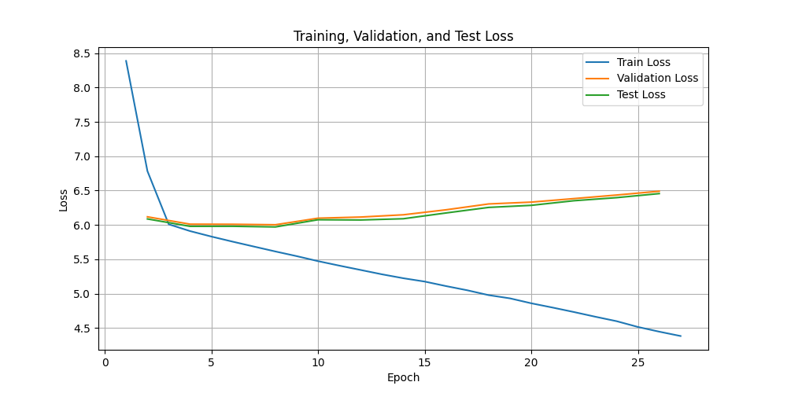
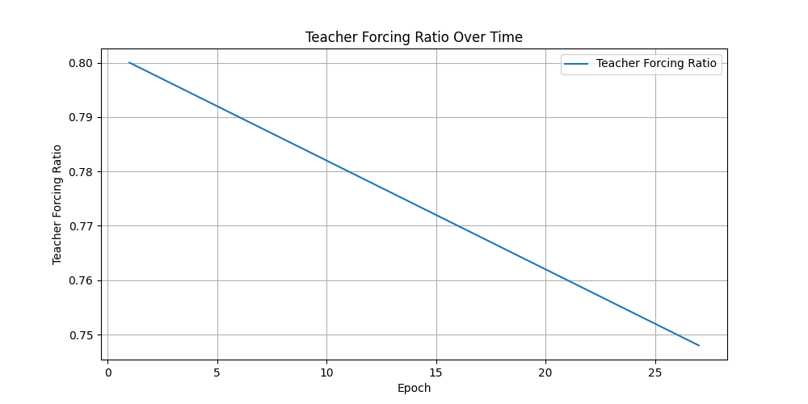
5000 Sentences – 27 Epochs

Slide 43
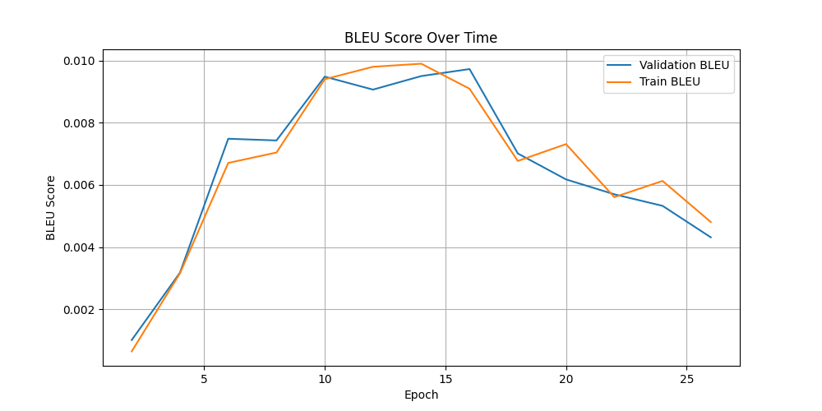
5000 Sentences – 27 Epochs

Slide 44
Final Remarks
Overfitting can be avoided by lowering number of epochs and decaying teacher forcing ratio accordingly
One of the major reasons for low BLEU score is OOV words or words that does not appear during training
We were able to handle overfitting and show that scalability is possible with more computationally intensive hyperparameter tuning

Slide 45
References

Slide 46
References Used
Learning Phrase Representations using RNN Encoder–Decoder for Statistical Machine Translation
Attention is all you need
Deep Sequence Modelling MIT Lecture 2025
Class Slides and Notes

Slide 47


